Slide 1

Cause of Death
Flip Robo technologies
Prepend By: -
Kishan Sapariya
SME
Khushboo Garg

Slide 2

About Dataset
In this Dataset, we have Historical Data of different cause of deaths for all ages around the World. The key features of this Dataset are: Meningitis, Alzheimer's Disease and Other Dementias, Parkinson's Disease, Nutritional Deficiencies, Malaria, Drowning, Interpersonal Violence, Maternal Disorders, HIV/AIDS, Drug Use Disorders, Tuberculosis, Cardiovascular Diseases, Lower Respiratory Infections, Neonatal Disorders, Alcohol Use Disorders, Self-harm, Exposure to Forces of Nature, Diarrheal Diseases, Environmental Heat and Cold Exposure, Neoplasms, Conflict and Terrorism, Diabetes Mellitus, Chronic Kidney Disease, Poisonings, Protein-Energy Malnutrition, Road Injuries, Chronic Respiratory Diseases, Cirrhosis and Other Chronic Liver Diseases, Digestive Diseases, Fire, Heat, and Hot Substances, Acute Hepatitis.

Slide 3

Analysis of Data
For analyse date we use Jupyter Notebook and many libraries such and Pandas, Numpy, for load data and fill data.
For visualization part we use Seaborn and Matplotlib for plot chart and visualize it.

Slide 4
Name of Columns
01. Country/Territory - Name of the Country/Territory
02. Code - Country/Territory Code
03. Year - Year of the Incident
04. Meningitis - No. of People died from Meningitis
05. Alzheimer's Disease and Other Dementias - No. of People died from Alzheimer's Disease and Other Dementias
06. Parkinson's Disease - No. of People died from Parkinson's Disease
07. Nutritional Deficiencies - No. of People died from Nutritional Deficiencies
08. Malaria - No. of People died from Malaria
09. Drowning - No. of People died from Drowning

Slide 5
Name of Columns
10. Interpersonal Violence - No. of People died from Interpersonal Violence
11. Maternal Disorders - No. of People died from Maternal Disorders
12. Drug Use Disorders - No. of People died from Drug Use Disorders
13. Tuberculosis - No. of People died from Tuberculosis
14. Cardiovascular Diseases - No. of People died from Cardiovascular Diseases
15. Lower Respiratory Infections - No. of People died from Lower Respiratory Infections
16. Neonatal Disorders - No. of People died from Neonatal Disorders
17. Alcohol Use Disorders - No. of People died from Alcohol Use Disorders
18. Self-harm - No. of People died from Self-harm.

Slide 6
Name of Columns
19. Exposure to Forces of Nature - No. of People died from Exposure to Forces of Nature
20. Diarrheal Diseases - No. of People died from Diarrheal Diseases
21. Environmental Heat and Cold Exposure - No. of People died from Environmental Heat and Cold Exposure
22. Neoplasms - No. of People died from Neoplasms
23. Conflict and Terrorism - No. of People died from Conflict and Terrorism
24. Diabetes Mellitus - No. of People died from Diabetes Mellitus
25. Chronic Kidney Disease - No. of People died from Chronic Kidney Disease
26. Poisonings - No. of People died from Poisoning
27. Protein-Energy Malnutrition - No. of People died from Protein-Energy Malnutrition

Slide 7
Name of Columns
28. Chronic Respiratory Diseases - No. of People died from Chronic Respiratory Diseases
29. Cirrhosis and Other Chronic Liver Diseases - No. of People died from Cirrhosis and Other Chronic Liver Diseases
30. Digestive Diseases - No. of People died from Digestive Diseases
31. Fire, Heat, and Hot Substances - No. of People died from Fire or Heat or any Hot Substances
32. Acute Hepatitis - No. of People died from Acute Hepatitis

Slide 8
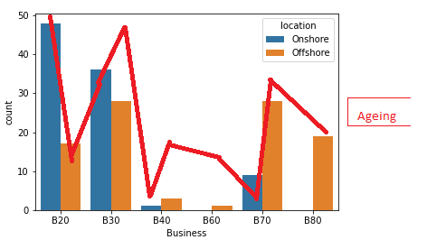
1. Univariate Analysis

Slide 9
Observation
1. Year in this column we observe that majority of data are equal with the year.
2. Menignits in this column we observe that majority of data are says that around 5000 persons died.
3. Alzheimer's Disease and Other Dementias in this column we observe that majority of data are says that around 12500 persons died.
4. Parkinson's Disease in this column we observe that majority of data are says that around 3000 persons died.
5. Nutritional Deficiencies in this column we observe that majority of data are says that around 10000 persons died.
6. Malaria in this column we observe that majority of data are says that very less persons died.
7. Drowning in this column we observe that majority of data are says that around 5000 persons died.
8. Interpersonal Violence in this column we observe that majority of data are says that around 5000 persons died.
9. Maternal Disorders in this column we observe that majority of data are says that around 4000 persons died.
10. HIV/AIDS in this column we observe that majority of data are says that around 10000 persons died.
11. Drug Use Disorders in this column we observe that majority of data are says that very less persons are died.
12. Tuberculosis in this column we observe that majority of data are says that around 20000 persons died.
13. cardiovascular diseases in this column we observe that majority of data are says that around 3000 persons died.
14. Lower Respiratory Infections in this column we observe that majority of data are says that around 25000 persons died.
15. Neonatal Disorders in this column we observe that majority of data are says that around 10000 persons died.
16. Alcohol Use Disorders in this column we observe that majority of data are says that around 5000 persons died.
17. Self-harm in this column we observe that majority of data are says that around 2500 persons died.
18. Exposure to Forces of Nature in this column we observe that majority of data are says that around 2000 persons died.
19. Diarrheal Diseases in this column we observe that majority of data are says that around 2000 persons died.

Slide 10
Observation
20. Environmental Heat and Cold Exposure in this column we observe that majority of data are says that around 3000 persons died.
21. Neoplasms in this column we observe that majority of data are says that around 2500 persons died.
22. Conflict and Terrorism in this column we observe that majority of data are says that around 1000 persons died.
23. Diabetes Mellitus in this column we observe that majority of data are says that around 25000 persons died.
24. chronic kidney disease in this column we observe that majority of data are says that around 25000 persons died.
25. Poisonings in this column we observe that majority of data are says that around 2500 persons died.
26. Protein-Energy Malnutrition in this column we observe that majority of data are says that very less persons died.
27. Road Injuries in this column we observe that majority of data are says that around 12500 persons died.
28. Chronic Respiratory Diseases in this column we observe that majority of data are says that around 2500 persons died.
29. Cirrhosis and Other Chronic Liver Diseases in this column we observe that majority of data are says that around 10000 persons died.
30. Digestive Diseases in this column we observe that majority of data are says that around 3000 persons died.
31. Fire, Heat, and Hot Substances in this column we observe that majority of data are says that around 2500 persons died.
32. Acute Hepatitis in this column we observe that majority of data are says that very less persons died.

Slide 11
Count Total death in each diseases

Slide 12
Observation
1. Year in these diseases there are total 12267540 persons are died.
2. Meningitis in these diseases there are total 10524572 persons are died.
3. Alzheimer's Disease and Other Dementias in this diseases there are total 29768839 persons are died.
4. Parkinson's Disease in this diseases there are total 7179795 persons are died.
5. Nutritional Deficiencies in this diseases there are total 13792032 persons are died.
6. Malaria in this diseases there are total 25342676 persons are died.
7. Drowning in this diseases there are total 10301999 persons are died.
8. Interpersonal Violence in this diseases there are total 12752839 persons are died.
Maternal Disorders in this diseases there are total 7727046 persons are died.
10. HIV/AIDS in this diseases there are total 36364419 persons are died.
11. Drug Use Disorders in this diseases there are total 2656121 persons are died.
12. Tuberculosis in this diseases there are total 45850603 persons are died.
13. Cardiovascular Diseases in this diseases there are total 447741982 persons are died.
14. Lower Respiratory Infections in this diseases there are total 83770038 persons are died.
15. Neonatal Disorders in this diseases there are total 76860729 persons are died.

Slide 13
Observation
16. Alcohol Use Disorders in this diseases there are total 4819018 persons are died.
17. Self-harm in this diseases there are total 23713931 persons are died.
18. Exposure to Forces of Nature in this diseases there are total 1490132 persons are died.
19. Diarrheal Diseases in this diseases there are total 66235508 persons are died.
20. Environmental Heat and Cold Exposure in this diseases there are total 1788851 persons are died.
21. Neoplasms in this diseases there are total 229758538 persons are died.
22. Conflict and Terrorism in this diseases there are total 3294053 persons are died.
23. Diabetes Mellitus in this diseases there are total 31448872 persons are died.
24. Chronic Kidney Disease in this diseases there are total 28911692 persons are died.
25. Poisonings in this diseases there are total 2601082 persons are died.
26. Protein-Energy Malnutrition in this diseases there are total 12031885 persons are died.
27. Road Injuries in this diseases there are total 36296469 persons are died.
28. Chronic Respiratory Diseases in this diseases there are total 104605334 persons are died.
29. Cirrhosis and Other Chronic Liver Diseases in this diseases there are total 37479321 persons are died.
30. Digestive Diseases in this diseases there are total 65638635 persons are died.

Slide 14
Observation
31. Fire, Heat, and Hot Substances in this diseases there are total 3602914 persons are died.
32. Acute Hepatitis in this diseases there are total 3784791 persons are died.
As we observe in the diseases of Cardiovascular there are maximum death 447741982.
As we observe in the diseases of Exposure to Forces of Nature there are maximum death 1490132.
As we observe there are total 1480402256 persons are died.

Slide 15
Bivariate Analysis

Slide 16
Observation X= Year
1. As we observe in this figure we observe that by increase year the death is decrease in the Meningitis diseases.
2. As we observe in this figure we observe that by increase year the death is also increase in the Alzheimer's Disease and Other Dementias diseases.
3. As we observe in this figure we observe that by increase year the death is also increase in the Parkinson's Disease diseases.
4. As we observe in this figure we observe that by increase year the death is decrease in the Nutritional Deficiencies diseases.
5. As we observe in this figure we observe that by year this is saturated but in last 4 to 5 years it will decrease the death of Malaria diseases.
6. As we observe in this figure we observe that by increase year the death is decrease in the Drowning diseases.
7. As we observe in this figure we observe that this is saturated and also stable in all the years. for Interpersonal Violence diseases death.
8. As we observe in this figure we observe that by increase year the death is decrease in the Maternal Disorders diseases.
9. As we observe in this figure we observe that in the year of 2001 to 2008 the death is higher now a days it will decrease by year in the HIV//AIDS diseases.
10. As we observe in this figure we observe that by increase year the death is also increase in the Drug Use Disorders diseases.
11. As we observe in this figure we observe that by increase year the death is decrease in the Tuberculosis diseases.
12. As we observe in this figure we observe that by increase year the death is also increase in the Cardiovascular diseases.
13. As we observe in this figure we observe that by increase year the death is decrease in the Lower Respiratory Infections diseases.
14. As we observe in this figure we observe that by increase year the death is decrease in the Neonatal Disorders diseases.
15. As we observe in this figure we observe that by increase year it will increase but in the year of 2004 and 2005 Alcohol Use Disorders diseases is high.

Slide 17
Observation X= Year
16. As we observe in this figure we observe that this is saturated and also stable in all the years. for Self-harm diseases death.
17. As we observe for Exposure to Forces of Nature death there are only the year of 1990,1991,2004,2008,2010 it was higher.
18. As we observe in this figure we observe that by increase year the death is decrease in the Diarrheal diseases.
19. As we observe in this figure we observe that this is saturated and also stable in all the years. for Environmental Heat and Cold Exposure diseases death.
20. As we observe in this figure we observe that by increase year the death is also increase in the Neoplasms diseases.
21. As we observe for Conflict and Terrorism there are only the year of 1994,2014 it was higher.
22. As we observe in this figure we observe that by increase year the death is also increase in the Diabetes Mellitus diseases.
23. As we observe in this figure we observe that by increase year the death is also increase in the Chronic Kidney Disease diseases.
24. As we observe in this figure we observe that this is saturated and also stable in all the years. for Poisonings diseases death.
25. As we observe in this figure we observe that by increase year the death is decrease in the Protein-Energy Malnutrition diseases.
26. As we observe in this figure we observe that this is saturated and also stable in all the years. for Road Injuries diseases death.
27. As we observe in this figure we observe that by increase year the death is also increase in the Chronic Respiratory diseases.
28. As we observe in this figure we observe that by increase year the death is also increase in the Cirrhosis and Other Chronic Liver diseases.
29. As we observe in this figure we observe that by increase year the death is also increase in the Digestive diseases.
30. As we observe in this figure we observe that this is saturated and also stable in all the years. for Fire, Heat, and Hot Substances diseases death.
31. As we observe in this figure we observe that by increase year the death is decrease in the Acute Hepatitis diseases.

Slide 18
Observation X= Country
1. As we observe in the graph we observe that all the country are same death rate by year.
2. As we observe in the graph we observe that IND,NGK and PAK has highest death in the diseases of Meningitis.
3. As we observe in the graph we observe that CHN,USA,JPN and IND has highest death in the diseases of Alzheimer's Disease and Other Dementias.
4. As we observe in the graph we observe that CHN,USA and IND has highest death in the diseases of Parkinson's Disease.
5. As we observe in the graph we observe that ETH and IND has highest death in the diseases of Nutritional Deficiencies.
6. As we observe in the graph we observe that NGA,COD and IND has highest death in the diseases of Malaria.
7. As we observe in the graph we observe that CHN and IND has highest death in the diseases of Drowning.
8. As we observe in the graph we observe that BRA,CHN,COL,IND and RUS has highest death in the diseases of Interpersonal Violence.
9. As we observe in the graph we observe that IND has highest death in the diseases of Maternal Disorders.
10. As we observe in the graph we observe that ZAF,KEN and IND has highest death in the diseases of HIV/AIDS.
11. As we observe in the graph we observe that USA,CHN and RUS has highest death in the diseases of Drug Use Disorders.
12. As we observe in the graph we observe that IDN and IND has highest death in the diseases of Tuberculosis.
13. As we observe in the graph we observe that CHN and IND has highest death in the diseases of Cardiovascular Diseases.
14. As we observe in the graph we observe that NGA,CHN and IND has highest death in the diseases of Lower Respiratory Infections.
15. As we observe in the graph we observe that PAK and IND has highest death in the diseases of Neonatal Disorders.
16. As we observe in the graph we observe that RUS,CHN and IND has highest death in the diseases of Alcohol Use Disorders.
17. As we observe in the graph we observe that CHN and IND has highest death in the diseases of Self-harm.
18. As we observe in the graph we observe that IDN,HTI,BGD,CHN and MMR has highest death in the diseases of Exposure to Forces of Nature.
19. As we observe in the graph we observe that NGA and IND has highest death in the diseases of Diarrheal Diseases.
20. As we observe in the graph we observe that RUS,CHA and IND has highest death in the diseases of Environmental Heat and Cold Exposure.

Slide 19
Observation X= Country
21. As we observe in the graph we observe that CHA and USA has highest death in the diseases of Neoplasms.
22. As we observe in the graph we observe that RWA and SYR has highest death in the diseases of Conflict and Terrorism.
23. As we observe in the graph we observe that IDN,CHA and IND has highest death in the diseases of Diabetes Mellitus.
24. As we observe in the graph we observe that CHA and IND has highest death in the diseases of Chronic Kidney Disease.
25. As we observe in the graph we observe that CHA and RUS has highest death in the diseases of Poisonings.
26. As we observe in the graph we observe that ETH and IND has highest death in the diseases of Protein-Energy Malnutrition.
27. As we observe in the graph we observe that CHA and IND has highest death in the diseases of Road Injuries.
28. As we observe in the graph we observe that CHA and IND has highest death in the diseases of Chronic Respiratory Diseases.
29. As we observe in the graph we observe that IDN,CHA and IND has highest death in the diseases of Cirrhosis and Other Chronic Liver Diseases.
30. As we observe in the graph we observe that IDN,CHA and IND has highest death in the diseases of Digestive Diseases.
31. As we observe in the graph we observe that CHA,RUS and IND has highest death in the diseases of Fire, Heat, and Hot Substances.
32. As we observe in the graph we observe that IND has highest death in the diseases of Acute Hepatitis.

Slide 20
Multivariate Analysis
Multivariate analysis we use heat map.
There are some relationships with our target variable.
As we observe in above graph there are majority of the columns are in positively correlated

Slide 21
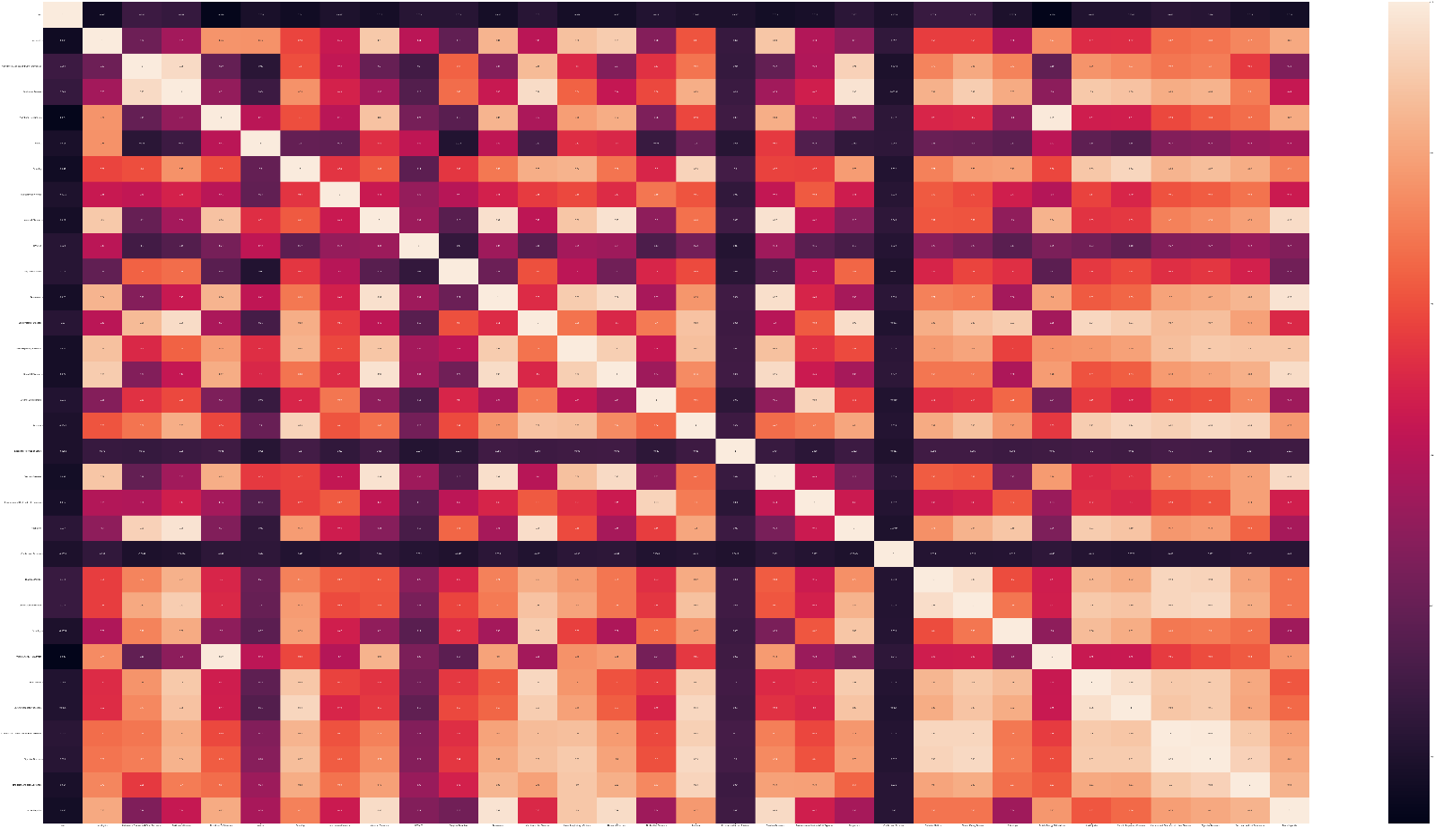

Slide 22

Power BI Dashboard
We made one simple PowerBI Dashboard for data analysis here the outlook of it.

Slide 23
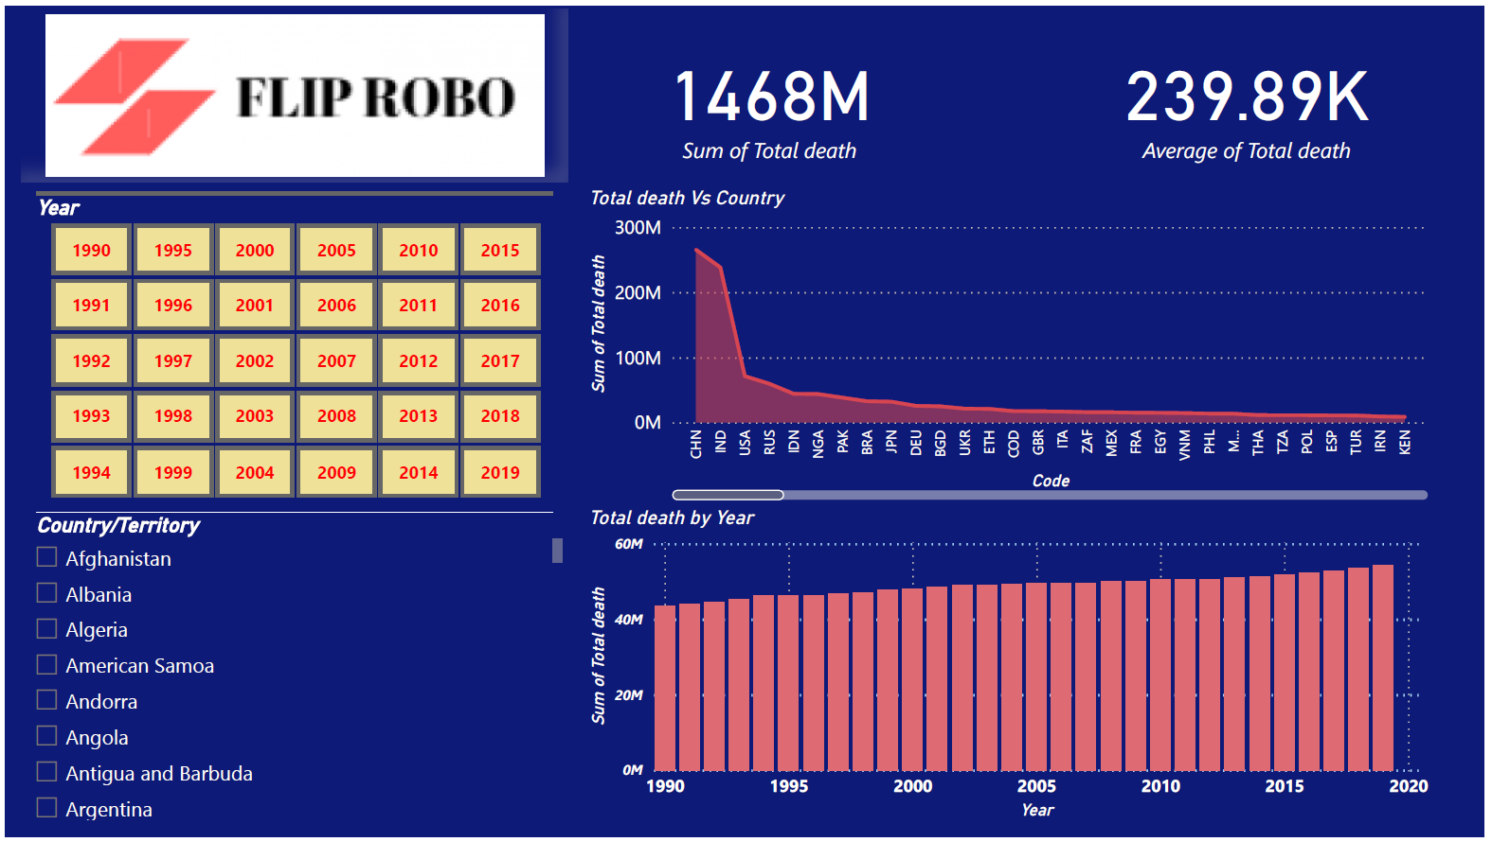

Slide 24
Thank you

